Slide 1
RUNGTA COLLEGE OF DENTAL SCIENCES & RESEARCH ANTI - HYPERTENSIVE AGENTS Department of Pharmacology

Slide 2
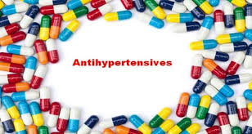

Slide 4
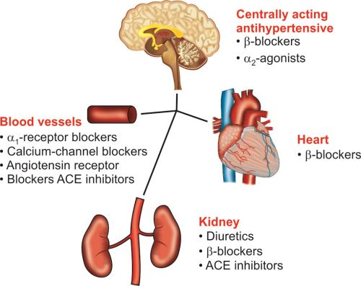

Slide 6
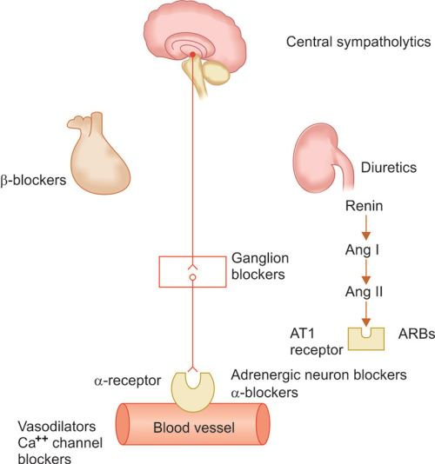

Slide 7
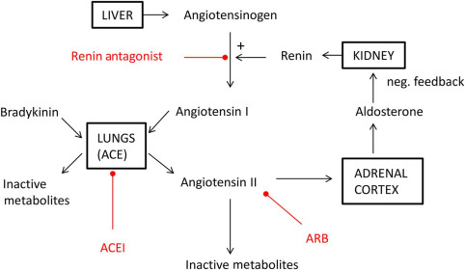

Slide 9
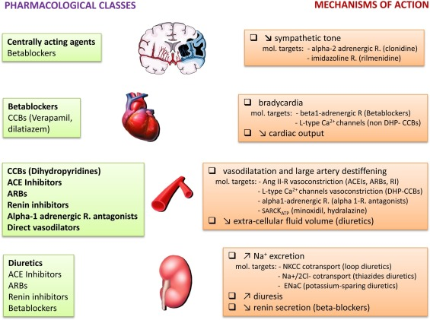

Slide 10
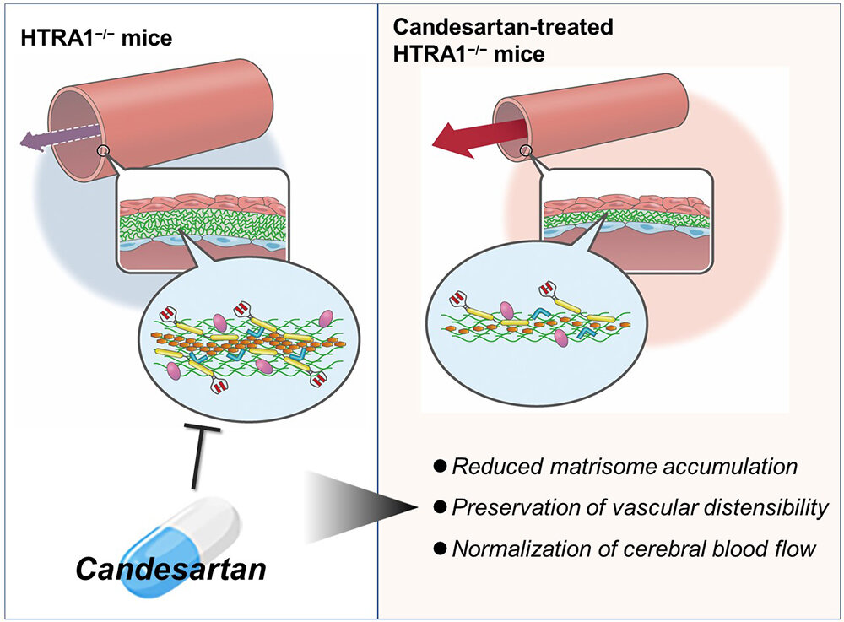

Slide 11
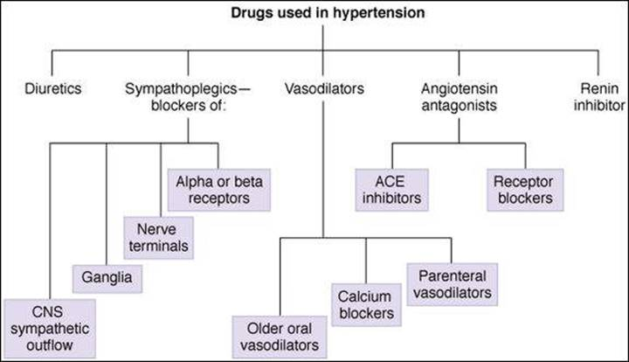

Slide 14
